Slide 1

3D Augmented Reality Head Up Display in Vehicles
Sydney Schultz

Slide 2
CY Vision
Tech company based out of California
Specializes in 3D displays
Develops 3D display technology that delivers augmented reality experiences in vehicles that accounts for distractions, navigation, and other features
Built for existing platforms and sensors
Can adapt to different vehicle models and different ergonomic needs
Notes:
Tech company based out of California
Specializes in 3D displays
Develops 3D display technology that delivers augmented reality experiences in vehicles that accounts for distractions, navigation, and other features
Built for existing platforms and sensors
Can adapt to different vehicle models and different ergonomic needs
On their website they say:
”Built for resilience and adaptability, our systems seamlessly integrate with various vehicle models, ensuring every ride is safe, immersive, and exceptional.”

Slide 3
Current Driving Challenges
The Fear of the Unknown
Nearly 75% of drivers are apprehensive about autonomous driving technology.
The Cost of Distraction
Distracted driving results in over 270,000 injuries and 3,000 deaths in the U.S. annually.
The Trust Barrier
Despite advancements, the market remains hesitant about fully embracing next-gen driving technologies.
Notes:
CY Vision lists challenges of driving in the “modern world”. These include:
The Fear of the Unknown
-Nearly 75% of drivers are apprehensive about autonomous driving technology.
The Cost of Distraction
-Distracted driving results in over 270,000 injuries and 3,000 deaths in the U.S. annually.
The Trust Barrier
-Despite advancements, the market remains hesitant about fully embracing next-gen driving technologies.

Slide 4
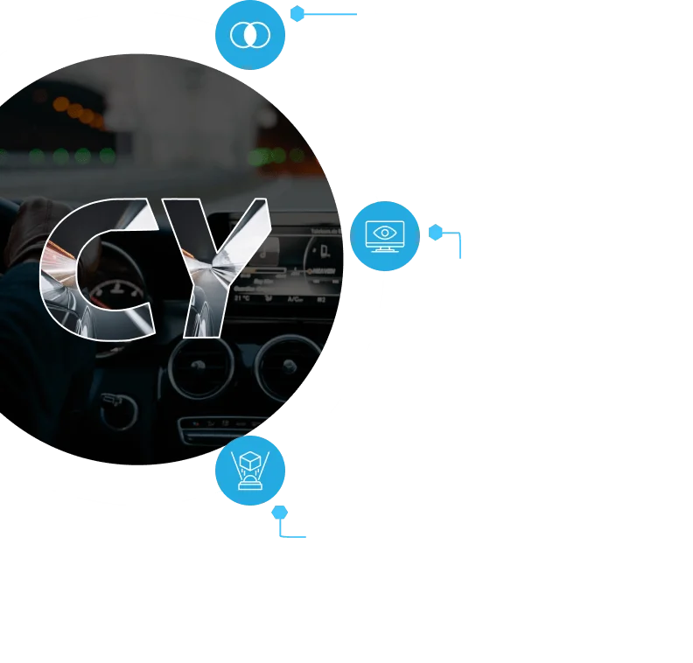
Safe and Engaging Visual Experiences

Slide 5
Display Features
Boundless Perspective
Wide Field of View: Capturing the entirety of the driving environment for a comprehensive visual experience.
Unrestricted Clarity
All Distances: Stay updated, from immediate in-cabin alerts to distant road signs and landmarks.
Unyielding Brilliance
All-Weather Performance: Maintain impeccable display clarity, irrespective of external weather conditions.
Notes:
CY Claims they use ”beyond conventional displays”.
Boundless Perspective
Wide Field of View Capturing the entirety of the driving environment for a comprehensive visual experience.
Unrestricted Clarity
All Distances Stay updated, from immediate in-cabin alerts to distant road signs and landmarks.
Unyielding Brilliance
All-Weather Performance Maintain impeccable display clarity, irrespective of external weather conditions.

Slide 6
Benefits
Reduces “eyes-off-road” driver distraction and divided attention across roads and dashboard information
Increases attention to traffic conditions and vehicle performance
Projects turn-by-turn navigation instructions into drivers’ line-of-sight
Offers dynamic display with higher levels of automated driving systems
Provides opportunity for more immersive media content to be consumed in-vehicle
Notes:
AR Windshield Enables Next Level User Experiences and Future Opportunities by having these benefits
Reduces “eyes-off-road” driver distraction and divided attention across roads and dashboard information
Increases attention to traffic conditions and vehicle performance
Projects turn-by-turn navigation instructions into drivers’ line-of-sight
Offers dynamic display with higher levels of automated driving systems
Provides opportunity for more immersive media content to be consumed in-vehicle
“By seamlessly integrating essential driving data within a driver’s natural line of sight, we ensure safety, confidence, and enhanced connectivity on the road.”

Slide 7
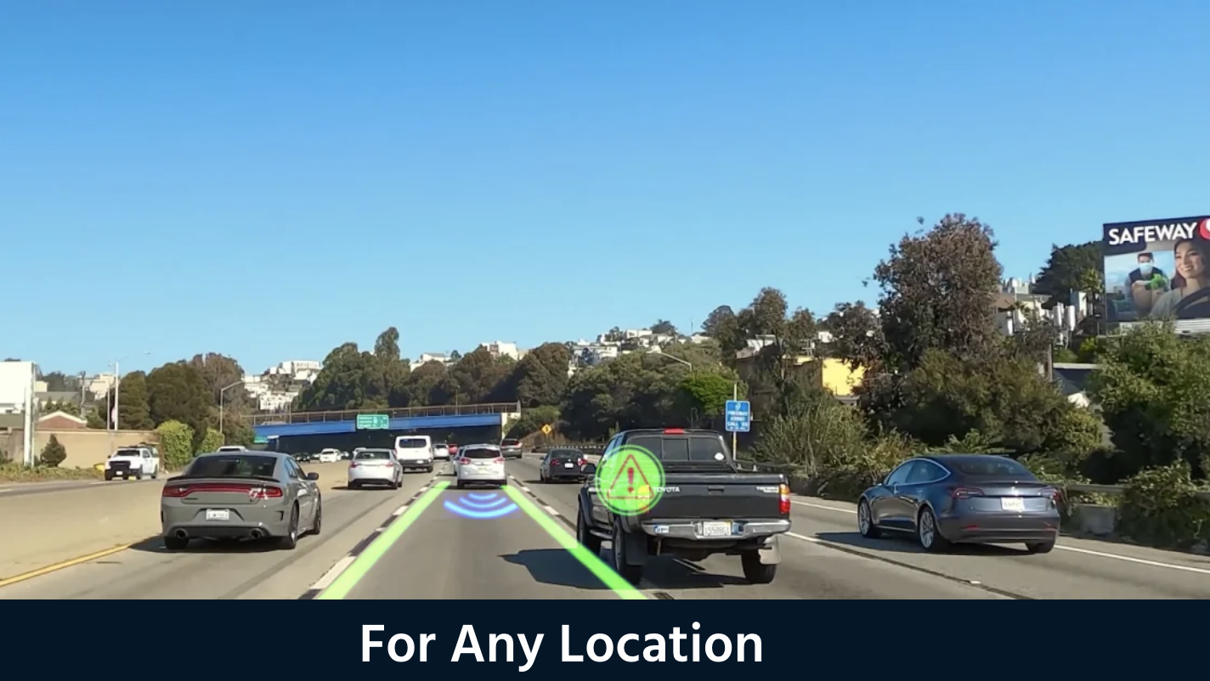

Slide 8
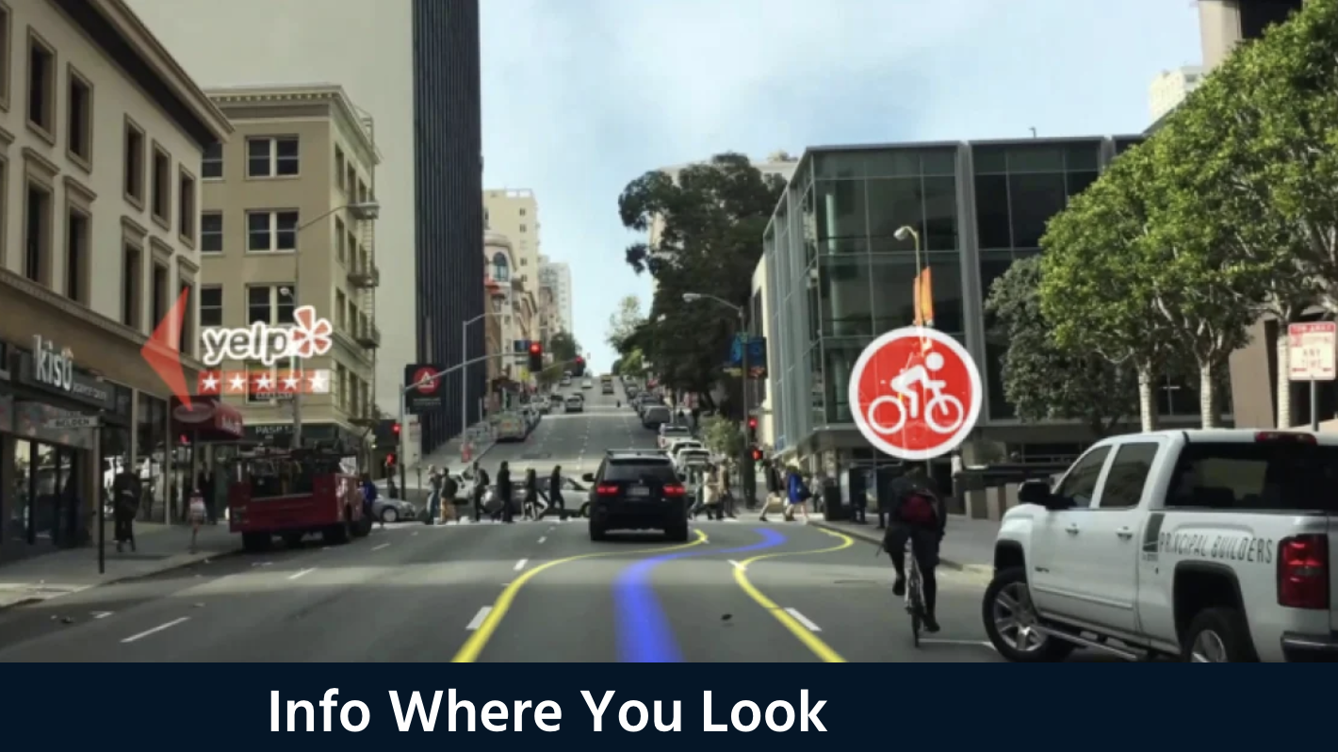

Slide 9
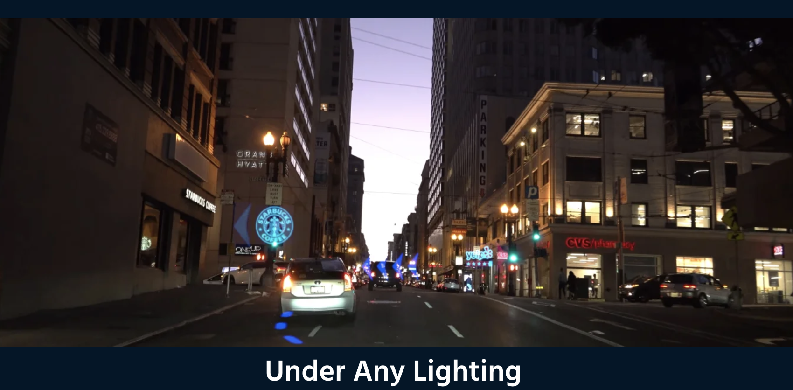

Slide 10
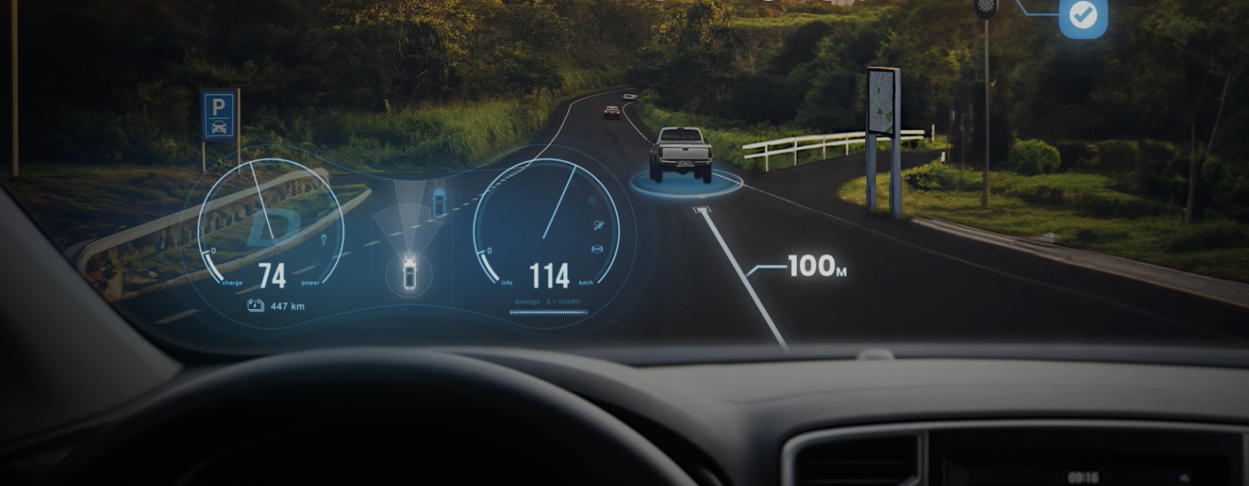
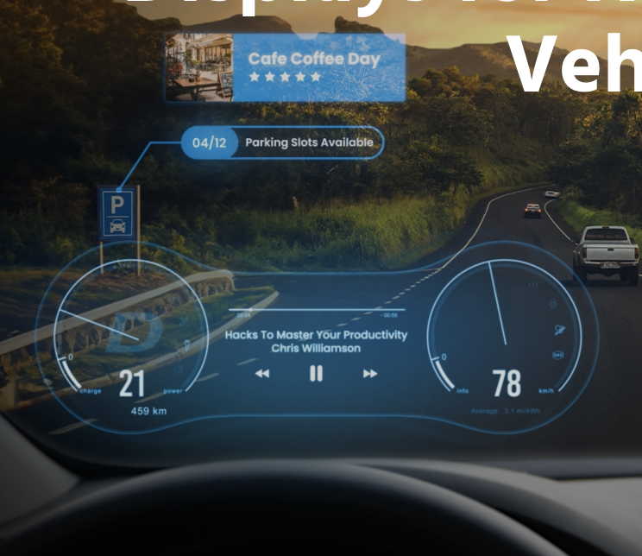
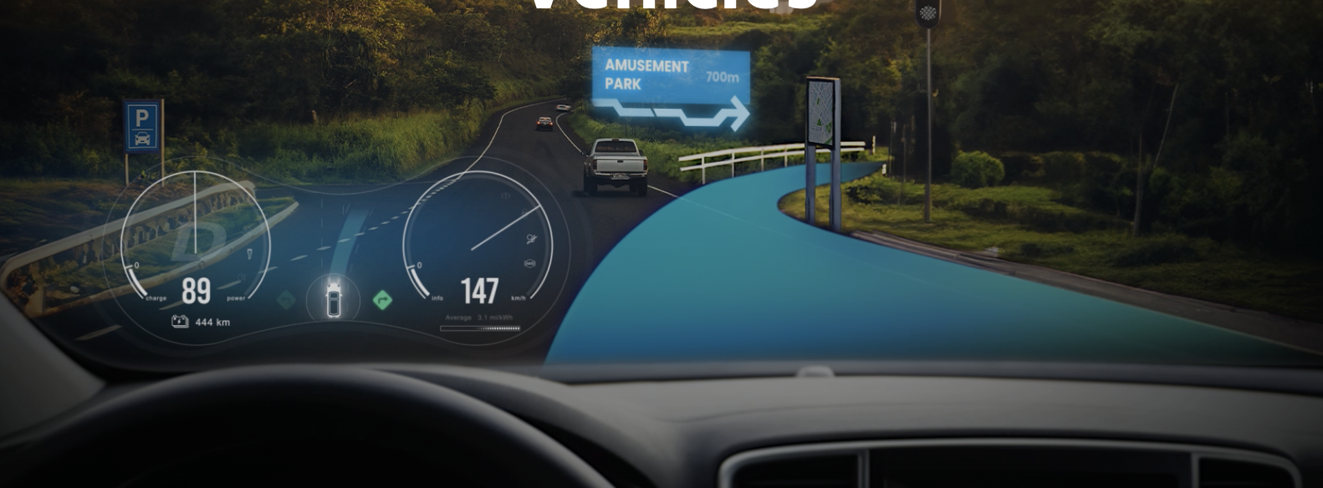
Travel Safety
Information
Navigation

Slide 11
Current AR Head Up Displays

Slide 12
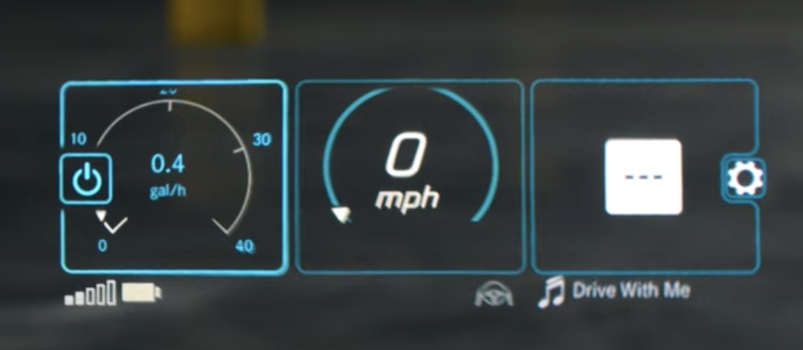
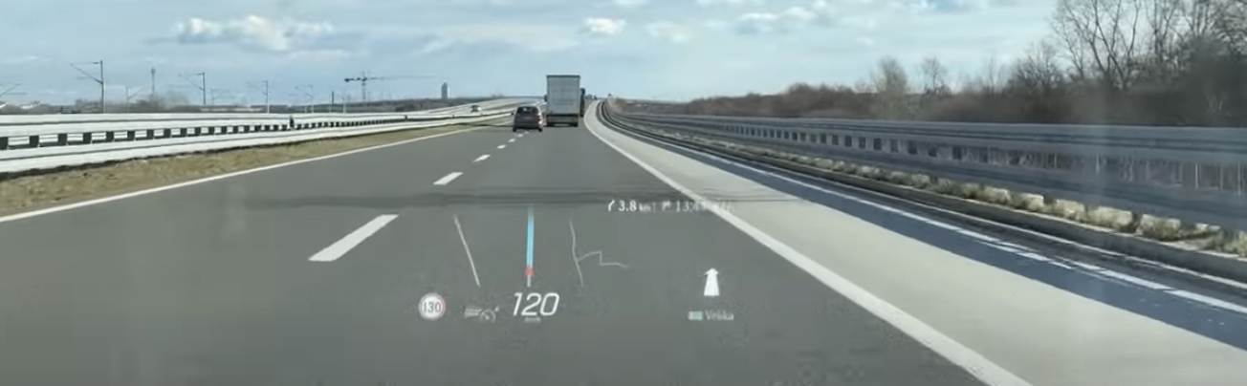
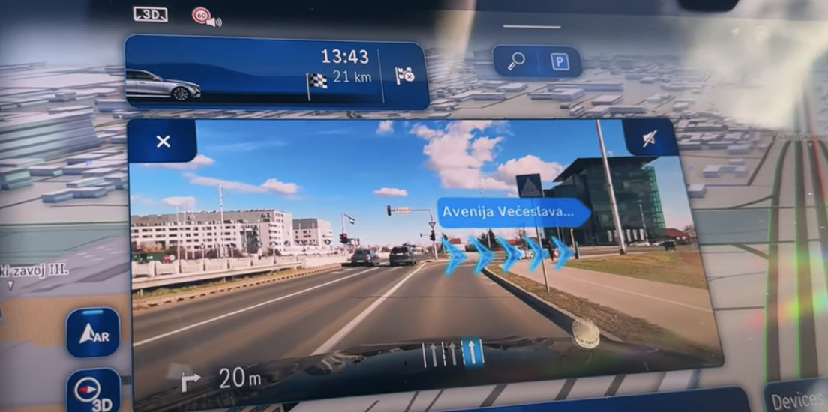
Mercedes-Benz User Experience (MBUX) 2024
2D Head Up Display
Navigation, Speed, Music, Settings
3D Display on Dashboard screen
Navigation, Traffic Conditions, Music, etc.
Very similar style to CY Vision
https://www.youtube.com/watch?app=desktop&v=veaBvReIB04

Slide 13
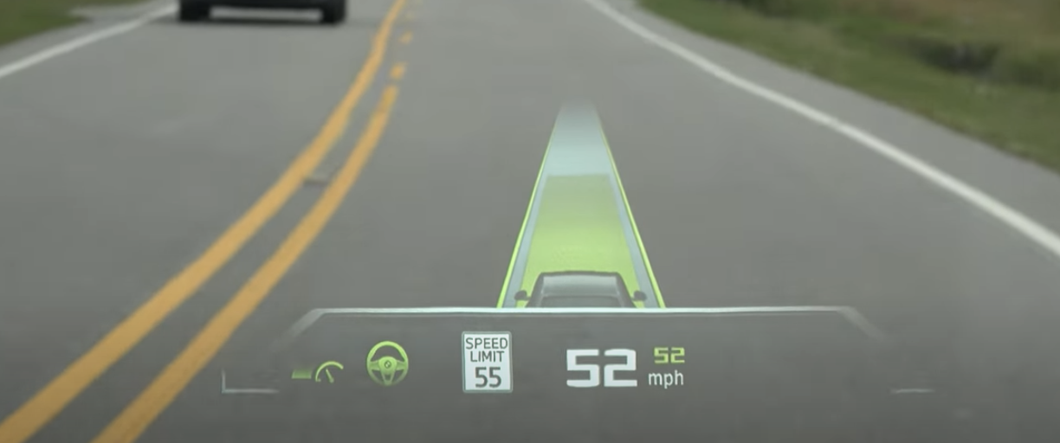
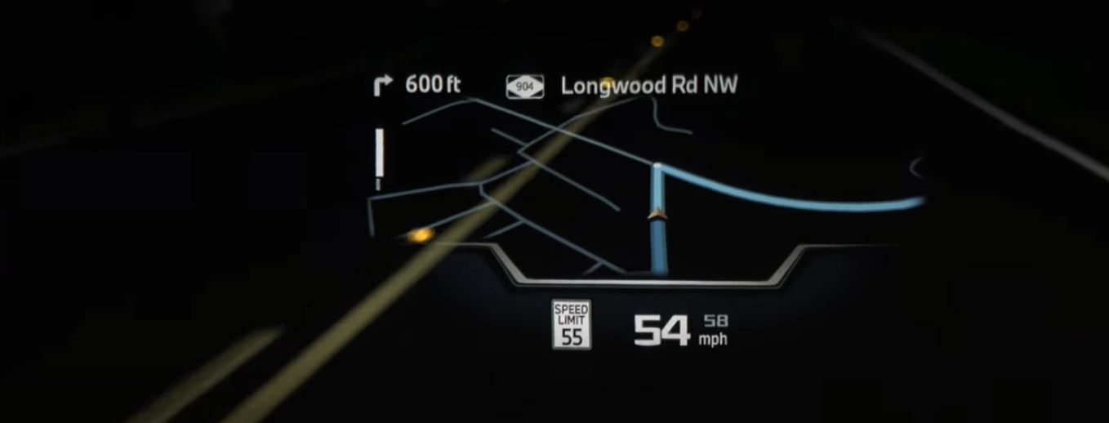
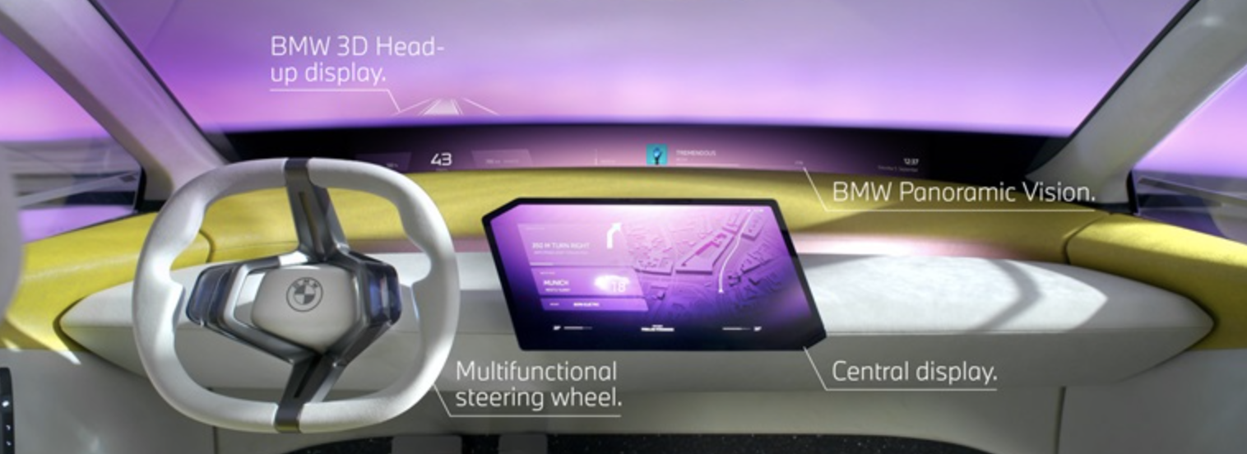
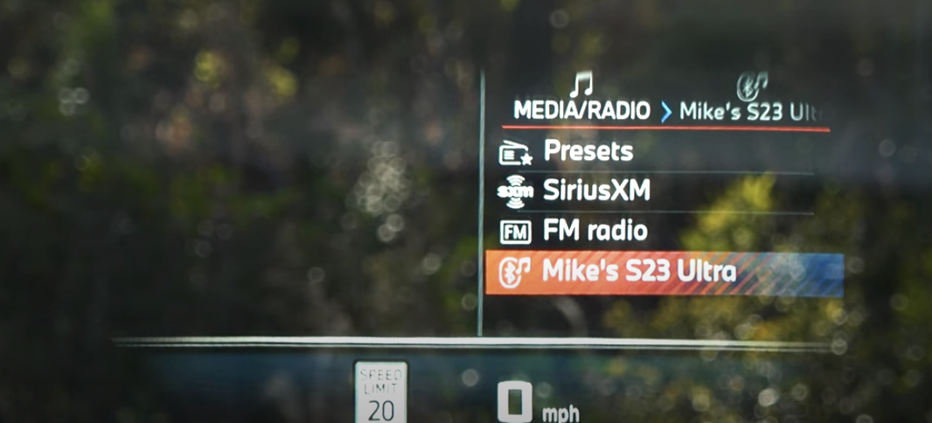
BMW 2024
2D and 3D Head Up Display
Navigation, Speed, Music, Settings
Panoramic Vision HUD
Set to debut in 2025
Display as wide as the dashboard
https://www.youtube.com/watch?v=iB3IddFXMIk
Notes:
Many other vehicle company’s have HUD but most are currently 2D displays. These were the most advanced displays I could find but many are going this direction and becoming more advanced.

Slide 14
Can Head-Up Displays Create More Distraction?

Slide 15
Potential Downsides to HUD
Distraction - While HUD aims to reduce distraction by displaying information directly in the driver's line of sight, poorly designed or overly complex HUD interfaces could still cause distraction if they require significant attention from the driver.
Information overload - Displaying too much information on the HUD could overwhelm the driver, leading to cognitive overload and distraction rather than enhancing situational awareness.
Glare and visibility issues - HUDs may suffer from glare, particularly in bright sunlight or when driving at night. This glare can reduce visibility and make it difficult for drivers to see the information displayed.
Dependency - Drivers may become overly reliant on the HUD for information, potentially leading to a decrease in situational awareness when the HUD is not available or malfunctions.
Notes:
Distraction: While HUD aims to reduce distraction by displaying information directly in the driver's line of sight, poorly designed or overly complex HUD interfaces could still cause distraction if they require significant attention from the driver.
Information overload: Displaying too much information on the HUD could overwhelm the driver, leading to cognitive overload and distraction rather than enhancing situational awareness.
Glare and visibility issues: HUDs may suffer from glare, particularly in bright sunlight or when driving at night. This glare can reduce visibility and make it difficult for drivers to see the information displayed.
Dependency: Drivers may become overly reliant on the HUD for information, potentially leading to a decrease in situational awareness when the HUD is not available or malfunctions.

Slide 16
Head-Up Displays and Distraction Potential Russell, S., Radlbeck, J., Atwood, J., Schaudt, W. A., & McLaughlin, S.
The main objective of this study was to determine whether HUD technology changes the driver’s ability to process information about the forward road scene and respond to crash-imminent situations.
Types of Distractions looked at:
Visual distraction: Tasks that require the driver to look away from the roadway to visually obtain information.
Manual distraction: Tasks that require the driver to take one or both hands off the steering wheel to manipulate a control, device, or other non-driving-related item.
Cognitive distraction: Tasks that require the driver to avert mental attention away from the driving task
Notes:
In a study by the U.S. Department of Transportation, National Highway Traffic Safety Administration in 2023, HUD was tested to see how it effects drivers.
The main objective of this study was to determine whether HUD technology changes the driver’s ability to process information about the forward road scene and respond to crash-imminent situations.
Types of Distractions looked at:
Visual distraction: Tasks that require the driver to look away from the roadway to visually obtain information.
Manual distraction: Tasks that require the driver to take one or both hands off the steering wheel to manipulate a control, device, or other non-driving-related item.
Cognitive distraction: Tasks that require the driver to avert mental attention away from the driving task

Slide 17
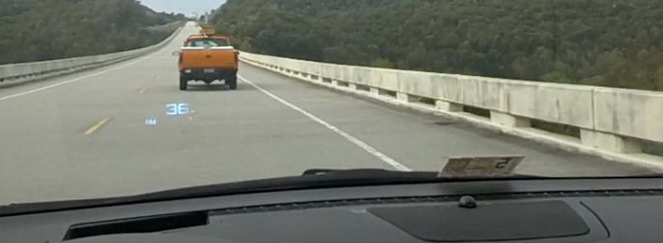
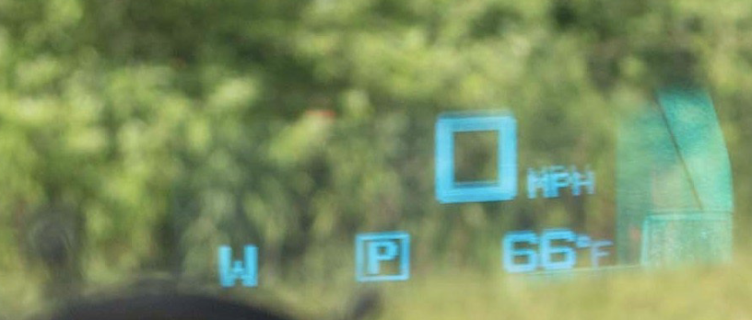
Head-Up Displays and Distraction Potential Russell, S., Radlbeck, J., Atwood, J., Schaudt, W. A., & McLaughlin, S.
Notes:
2010 Buick LaCrosse – old vehicle model
2D HUD not 3D

Slide 18
Head-Up Displays and Distraction Potential Russell, S., Radlbeck, J., Atwood, J., Schaudt, W. A., & McLaughlin, S.
Key Findings: - Glances to the HUD were faster than to the other displays when drivers obtained driving-related information (speed and direction). Overall task time was the same for all displays. - Drivers showed a tendency to glance at the HUD during samples of just driving (average glance duration was less than 2 seconds.) - When asked to read from the display, reaction times to the surprise event were equally slow when using the HUD as compared to other display conditions.
Notes:
Key Findings: - Glances to the HUD were faster than to the other displays when drivers obtained driving-related information (speed and direction). Overall task time was the same for all displays.
- Drivers showed a tendency to glance at the HUD during samples of just driving (average glance duration was less than 2 seconds.) - When asked to read from the display, reaction times to the surprise event were equally slow when using the HUD as compared to other display conditions.
Limitation:
eyes were drawn to the HUD display when it was available more than to the other displays but the HUD may have been novel to the participants in the study, and the study did not include an orientation period with the HUD, which could account for the results
Would findings be different with the more advanced 3D HUD rather than 2D?

Slide 19
References
Russell, S. M., Radlbeck, J., Atwood, J., Schaudt, W. A., McLaughlin, S. B., & Institute, V. T. T. (2023, January 1). Head-up displays and distraction potential. Home Page. https://doi.org/10.21949/1530265
https://cyvision.com/
https://cyvision.com/technology/
https://www.mbscottsdale.com/blog/how-to-use-mercedes-benz-head-up-display/
https://www.bmwblog.com/2024/01/28/new-bmw-head-up-display-5-series-2027-report/

